Slide 1

Analysis of Algorithms 1
(Fall 2011)
Istanbul Technical University
Computer Eng. Dept.
Chapter 13
Red-Black Trees
Last updated: December 03, 2009

Slide 2
Purpose
Review Binary Search Trees
Introduce Red-Black Trees
Review 2-3 and 2-3-4 trees
Rotations and other operations in RB Trees

Slide 3
Outline
Binary Search Tree (BST) review
Red and Black Trees
2-3 and 2-3-4 trees
Operations on Red and Black Trees

Slide 4
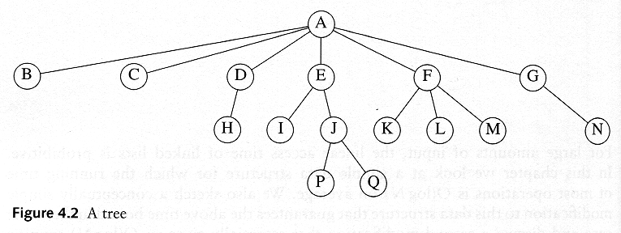
Tree
Child and parent
  Every node except the root has one parent
  A node can have an arbitrary number of children
Leaves: Nodes with no children
Sibling: nodes with same parent
Path Length: number of edges on the path
Depth of a node: length of the unique path from the root to that node. The depth of a tree is equal to the depth of the deepest leaf
Height of a node: length of the longest path from that node to a leaf, all leaves are at height 0, The height of a tree is equal to the height of the root
Ancestor and descendant
<number>/48

Slide 5
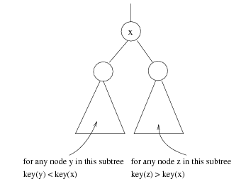
Binary Search Tree
Binary tree: A tree in which no node can have more than two children
Binary search tree:
Stores keys in the nodes in a way so that searching, insertion and deletion can be done efficiently.
For every node X, all the keys in its left subtree are smaller than the key value in X, and all the keys in its right subtree are larger than the key value in X
<number>/48

Slide 6


Binary Search Tree
A binary search tree
Not a binary search tree
WHY?
<number>/48

Slide 7
Binary Search Tree
A binary search tree
Not a binary search tree
Because 7>6
<number>/48

Slide 8
Binary Search Tree Operations
Tree Traversal: Used to print out the data in a tree in a certain order
Pre-order traversal (node-left-right)
  Print the data at the root
  Recursively print out all data in the left subtree
  Recursively print out all data in the right subtree
See also, post-order: left-right-node and in-order:left-node-right traversal.
<number>/48

Slide 9

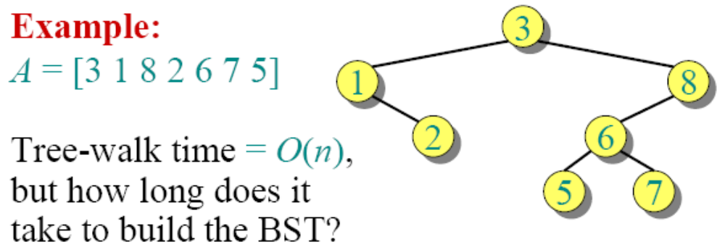
Binary-search-tree sort
Create an empty BST
for i = 1 to n
do TREE-INSERT (T, A[i])
Perform an inorder tree walk (traversal) of T.

Slide 10
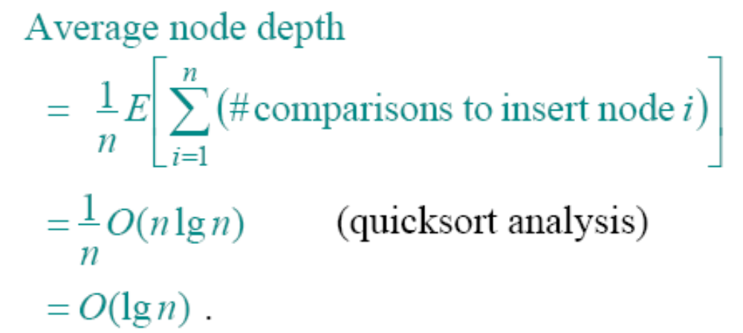
Node depth
The depth of a node = the number of comparisons
made during TREE-INSERT. Assuming all input
permutations are equally likely, we have
Average node depth

Slide 11
Height of a randomly built binary search tree
Outline of the analysis:
• Use Jensen’s inequality, which says that
f(E[X]) ≤ E[f(X)] for any convex function f and
random variable X.
• Analyze the exponential height of a randomly
built BST on n nodes, which is the random
variable Yn = 2^{Xn}, where Xn is the random
variable denoting the height of the BST.
• Prove that 2 ^{E[Xn]} ≤ E[2 ^{Xn} ] = E[Yn] = O(n³),
and hence that E[Xn] = O(lg n).

Slide 12
Binary Search Tree Operations
Linear access time of linked lists is prohibitive
Does there exist any simple data structure for which the running time of most operations (search, insert, delete) is O(log N)?
<number>/48

Slide 13

Two binary search trees representing
the same set.
Average depth of a node is O(log N); maximum depth of a node is O(N)
<number>/48

Slide 14
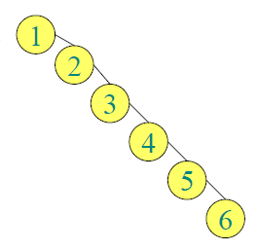
Balanced search trees, or how to avoid this even in the worst case
<number>/48

Slide 15

Balanced search tree
Balanced search tree: A search-tree data
structure for which a height of O(lg n) is
guaranteed when implementing a dynamic
set of n items.
Examples:
• AVL trees
• 2-3 trees
• 2-3-4 trees
• B-trees
• Red-black trees

Slide 16
Red-black trees
BSTs (Binary Search Tree) with an extra one-bit color field in each node.
Red-black properties:
Every node is either red or black.
The root and leaves (NIL’s) are black.
If a node is red, then its parent is black.
All simple paths from any node x to a descendant leaf have the same number of black nodes = black-height(x).

Slide 17
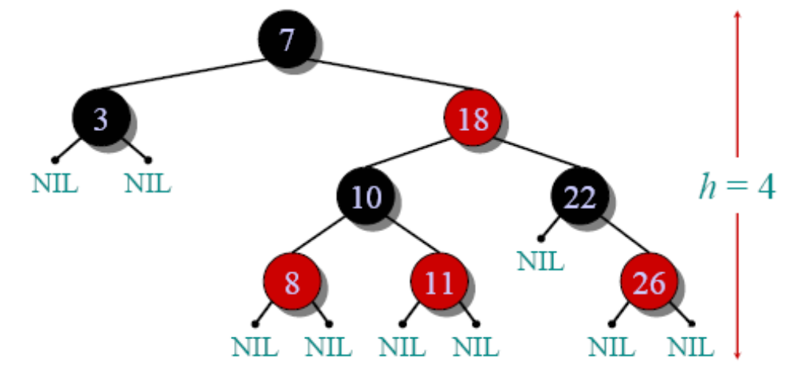
Red-black tree example

Slide 18
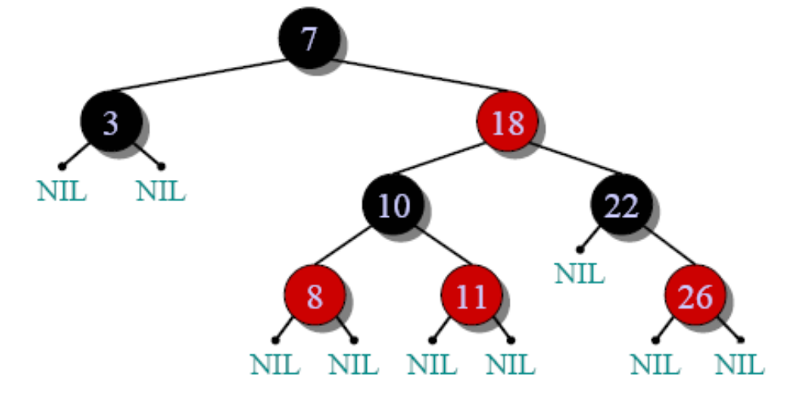
1. Every node is either red or black.

Slide 19
2. The root and leaves (NIL’s) are black.

Slide 20
3. If a node is red, then its parent is black.

Slide 21
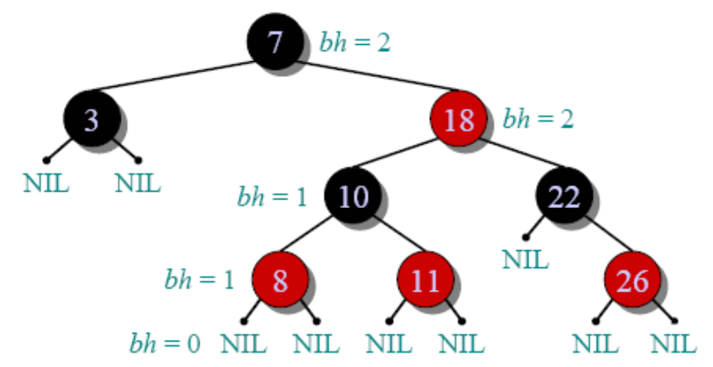
4. All simple paths from any node x to a descendant leaf have the same number of black nodes = black-height(x).

Slide 22
What properties would we like to prove about red-black trees ?
They always have O(log n) height
There is an O(log n) time insertion procedure which preserves the red-black properties
• Is it true that, after we add a new element to a tree, we can always recolor the tree to keep it red-black ?

Slide 23
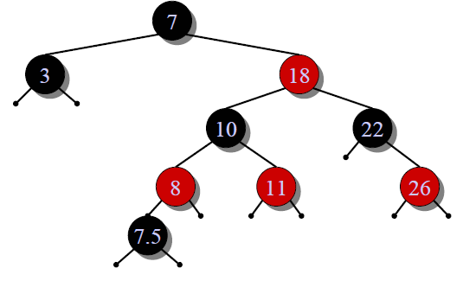
What properties would we like to prove about red-black trees ?
They always have O(log n) height
There is an O(log n) time insertion procedure which preserves the red-black properties
• Is it true that, after we add a new element to a tree, we can always recolor the tree to keep it red-black ?
NO. After insertions, sometimes we need to juggle nodes around

Slide 24
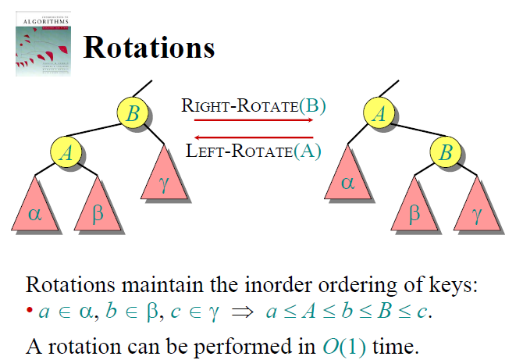

Slide 25
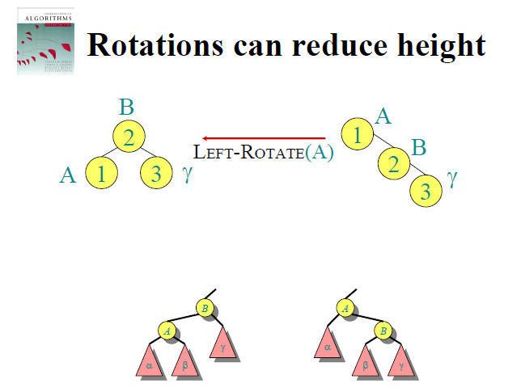

Slide 26
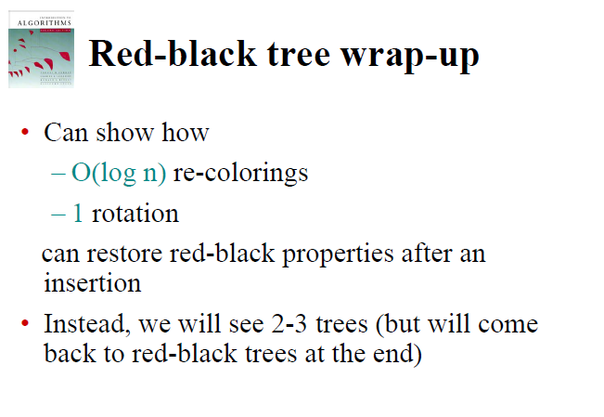

Slide 27
2-3 and 2-3-4 Trees

Slide 28
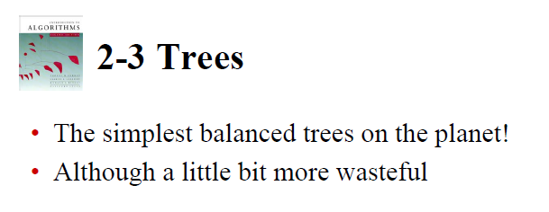
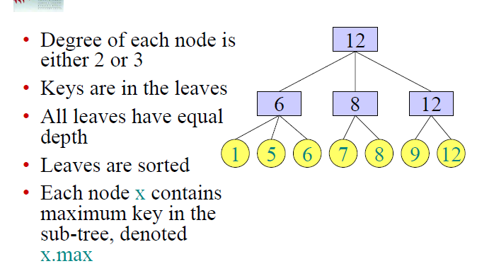

Slide 29
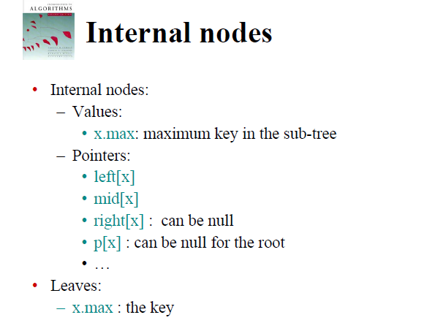

Slide 30
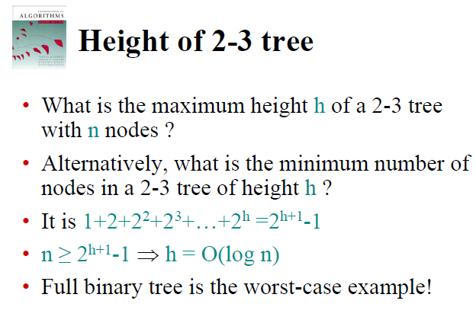

Slide 31
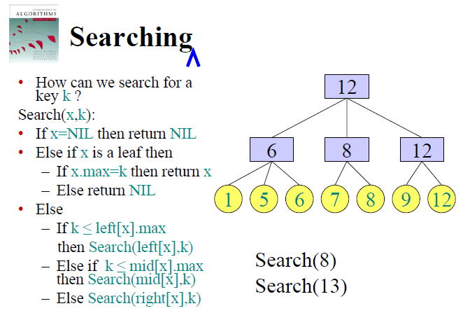

Slide 32
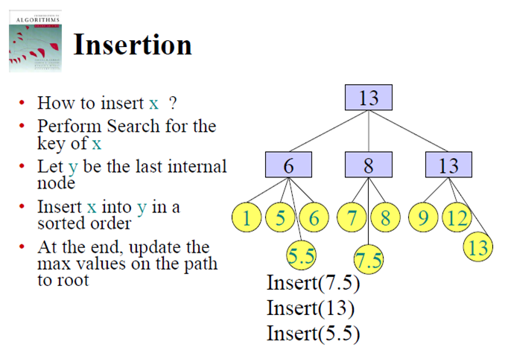
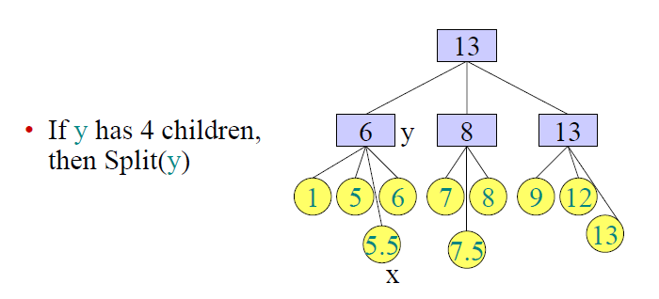

Slide 33
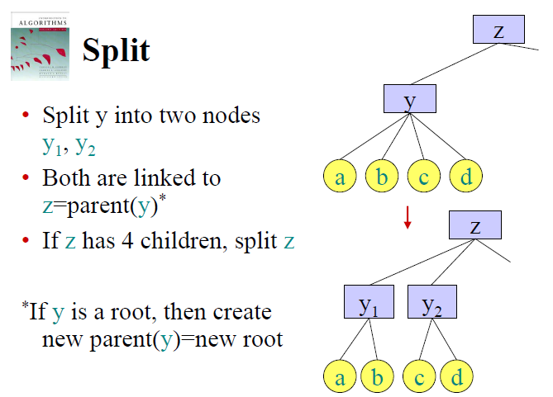

Slide 34
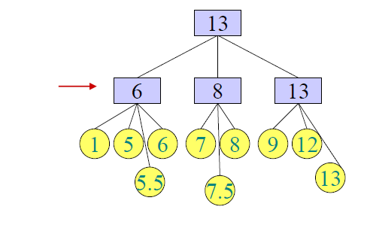
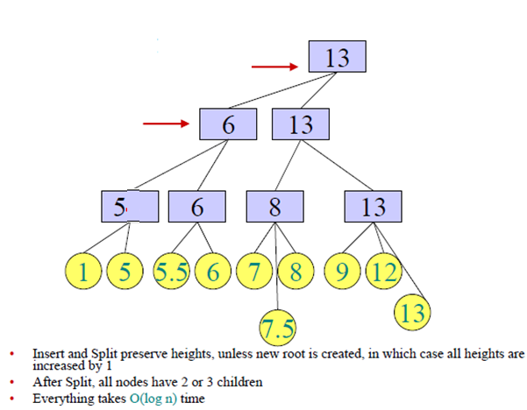

Slide 35
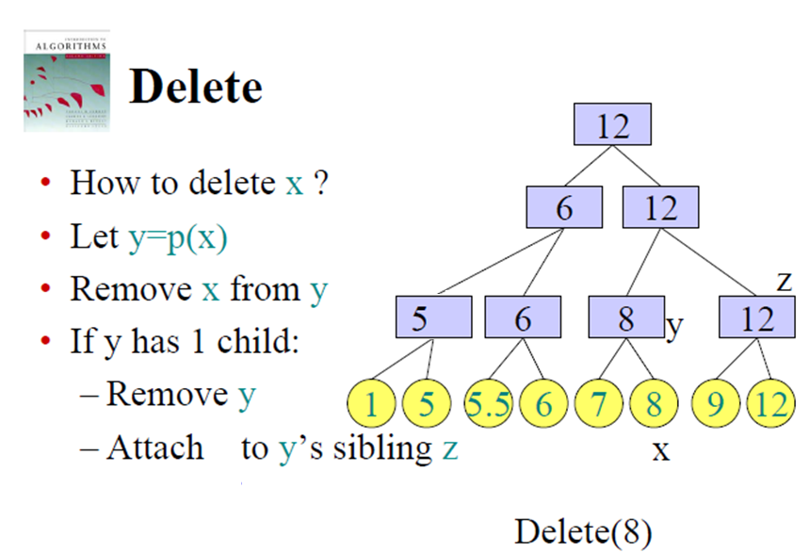

Slide 36
If z has 4 children, then Split(z)
INCOMPLETE – SEE THE END FOR FULL VERSION

Slide 37
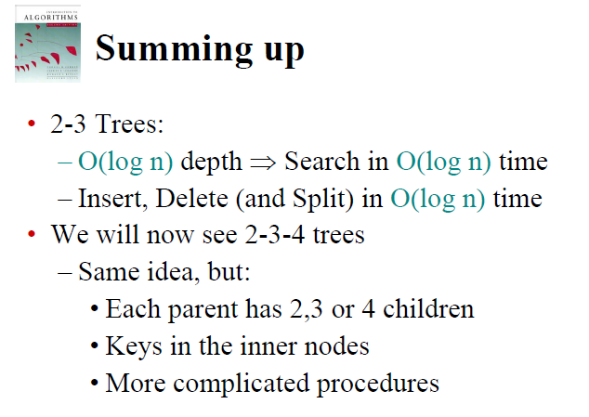

Slide 38
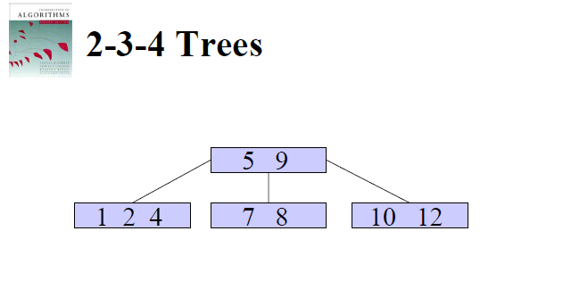

Slide 39
Back to Red and Black Trees

Slide 40
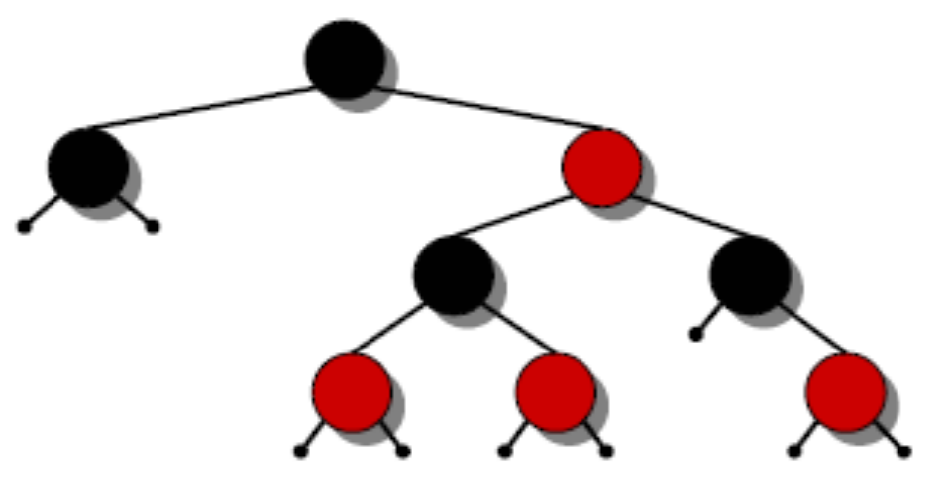
Height of a red-black tree
Theorem. A red-black tree with n keys has height
h ≤ 2 lg(n + 1).
Proof. (The book uses induction. Read carefully.)
INTUITION:
Merge red nodes into their black parents.

Slide 41
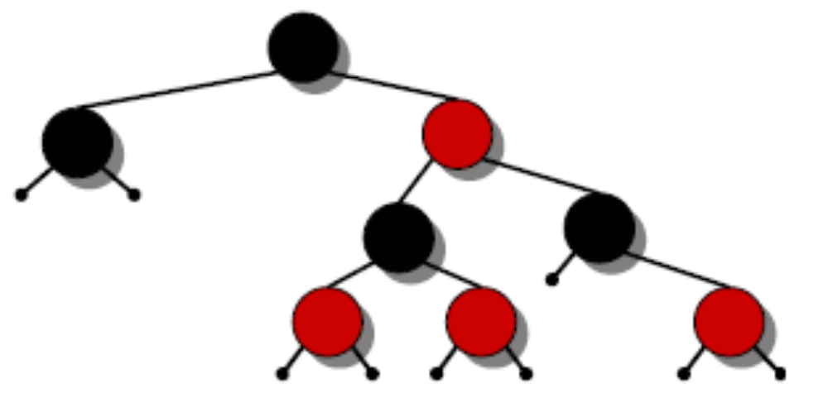
Height of a red-black tree
Theorem. A red-black tree with n keys has height
h ≤ 2 lg(n + 1).
Proof. (The book uses induction. Read carefully.)
INTUITION:
Merge red nodes into their black parents.

Slide 42
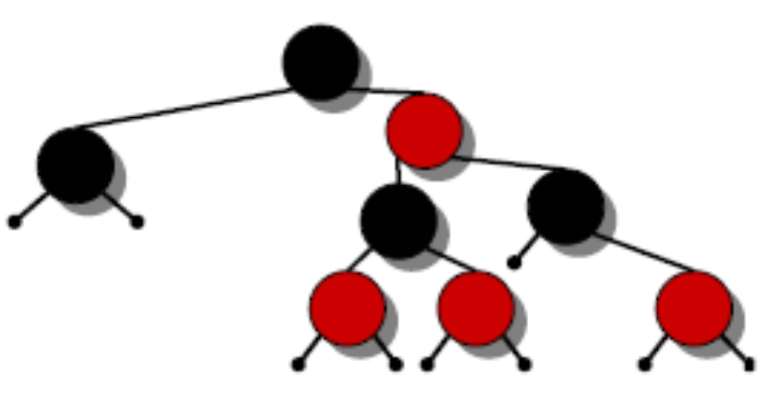
Height of a red-black tree
Theorem. A red-black tree with n keys has height
h ≤ 2 lg(n + 1).
Proof. (The book uses induction. Read carefully.)
INTUITION:
Merge red nodes into their black parents.

Slide 43
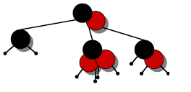
Height of a red-black tree
Theorem. A red-black tree with n keys has height
h ≤ 2 lg(n + 1).
Proof. (The book uses induction. Read carefully.)
INTUITION:
Merge red nodes into their black parents.

Slide 44
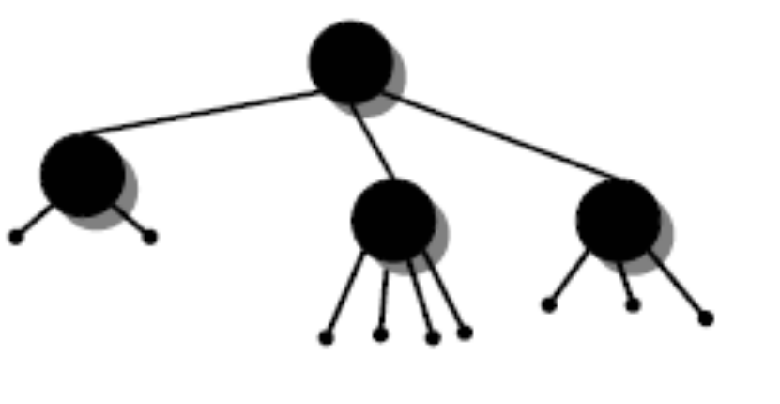
Height of a red-black tree
Theorem. A red-black tree with n keys has height
h ≤ 2 lg(n + 1).
Proof. (The book uses induction. Read carefully.)
INTUITION:
Merge red nodes into their black parents.

Slide 45
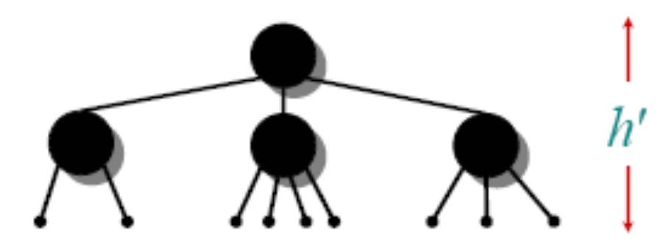
Height of a red-black tree
Theorem. A red-black tree with n keys has height
h ≤ 2 lg(n + 1).
Proof. (The book uses induction. Read carefully.)
INTUITION:
• Merge red nodes
into their black
parents.
• This process produces a tree in which each node has 2, 3, or 4 children.
• The 2-3-4 tree has uniform depth h' of leaves.

Slide 46
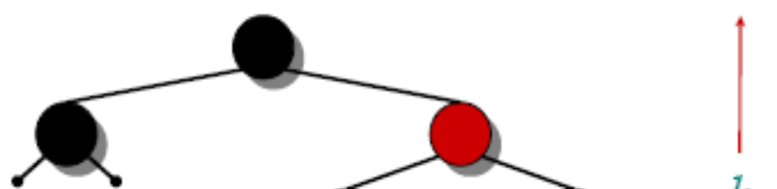
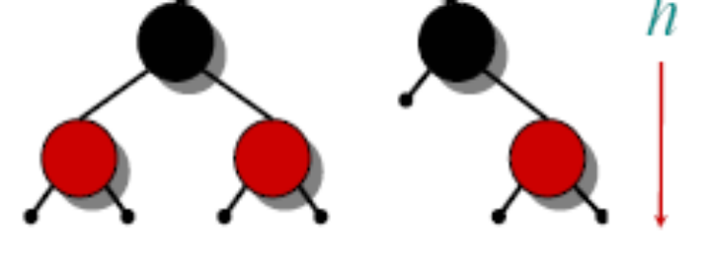
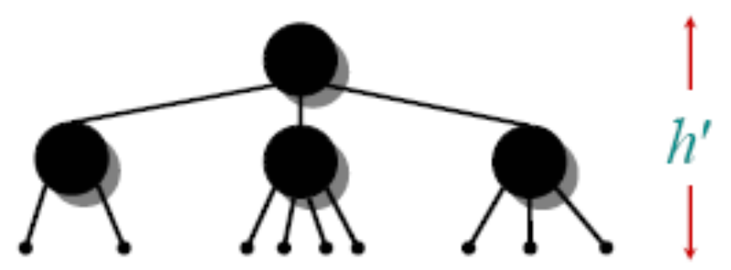
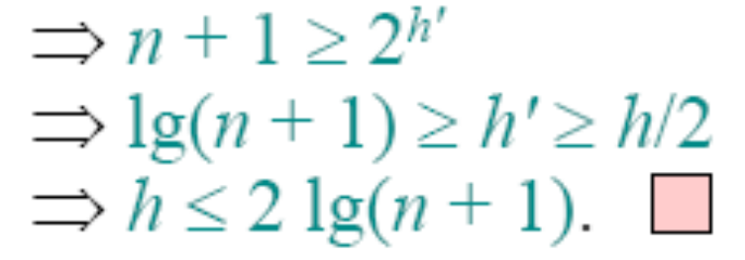
Height of a red-black tree
• We have
h' ≥ h/2, since
at most half
the leaves on any path
are red.
• The number of leaves
in each tree is n + 1

Slide 47
Query operations
Corollary. The queries SEARCH, MIN,
MAX, SUCCESSOR, and PREDECESSOR
all run in O(lg n) time on a red-black
tree with n nodes.
Modifying operations
The operations INSERT and DELETE cause modifications to the red-black tree:
• the operation itself,
• color changes,
• restructuring the links of the tree via “rotations”.

Slide 48
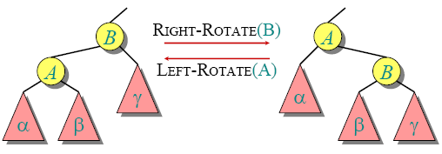
Rotations
Rotations maintain the inorder ordering of keys:
• a ∈ α, b ∈ β, c ∈ γ ⇒ a ≤ A ≤ b ≤ B ≤ c.
A rotation can be performed in O(1) time.

Slide 49
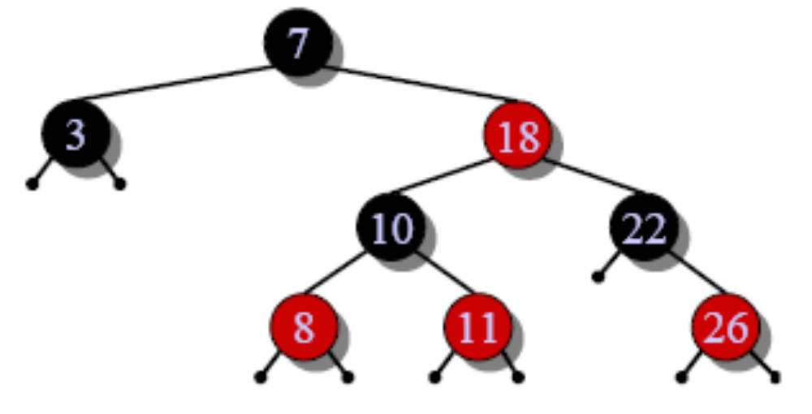
Insertion into a red-black tree
IDEA: Insert x in tree. Color x red. Only redblack property 3 might be violated. Move the violation up the tree by recoloring until it canbe fixed with rotations and recoloring.
Example:

Slide 50

Insertion into a red-black tree
IDEA: Insert x in tree. Color x red. Only redblack property 3 might be violated. Move the violation up the tree by recoloring until it canbe fixed with rotations and recoloring.
Example:
• Insert x =15.
• Recolor, moving the
violation up the tree.

Slide 51
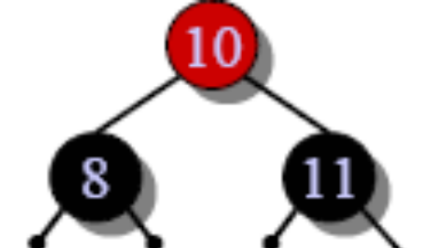
Insertion into a red-black tree
IDEA: Insert x in tree. Color x red. Only redblack property 3 might be violated. Move the violation up the tree by recoloring until it canbe fixed with rotations and recoloring.
Example:
• Insert x =15.
• Recolor, moving the
violation up the tree.
• RIGHT-ROTATE(18).

Slide 52
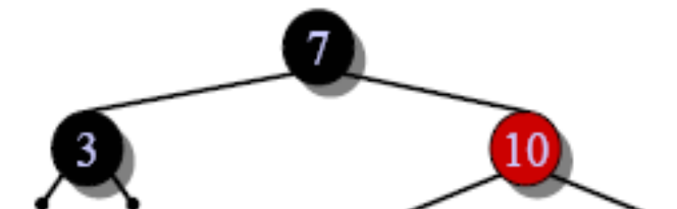
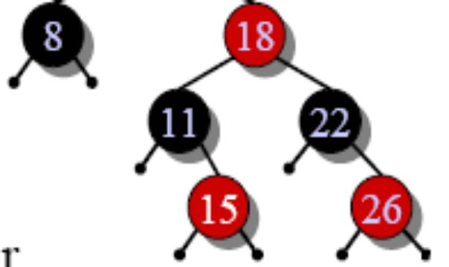
Insertion into a red-black tree
IDEA: Insert x in tree. Color x red. Only redblack
property 3 might be violated. Move the
violation up the tree by recoloring until it can
be fixed with rotations and recoloring.
Example:
• Insert x =15.
• Recolor, moving the
violation up the tree.
• RIGHT-ROTATE(18).
• LEFT-ROTATE(7) and recolor.

Slide 53
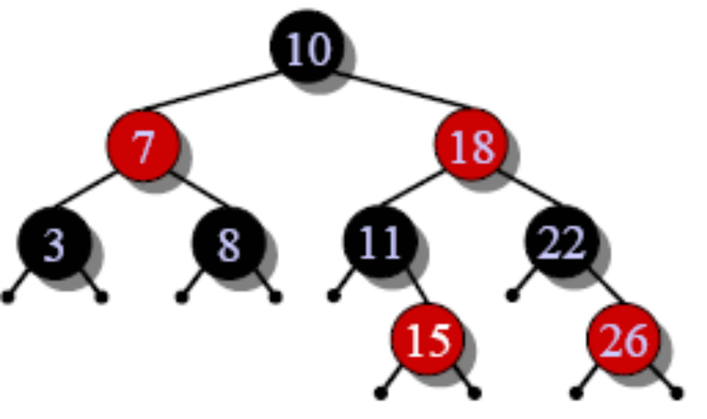
Insertion into a red-black tree
IDEA: Insert x in tree. Color x red. Only redblack
property 3 might be violated. Move the
violation up the tree by recoloring until it can
be fixed with rotations and recoloring.
Example:
• Insert x =15.
• Recolor, moving the
violation up the tree.
• RIGHT-ROTATE(18).
• LEFT-ROTATE(7) and recolor.

Slide 54
Pseudocode
RB-INSERT(T, x)
TREE-INSERT(T, x)
color[x] ← RED ⊳ only RB property 3 can be violated
while x ≠ root[T] and color[p[x]] = RED
do if p[x] = left[p[p[x]]
then y ← right[p[p[x]] ⊳ y = aunt/uncle of x
if color[y] = RED
then 〈Case 1〉
else if x = right[p[x]]
then 〈Case 2〉 ⊳ Case 2 falls into Case 3
〈Case 3〉
else 〈“then” clause with “left” and “right” swapped〉
color[root[T]] ← BLACK

Slide 55

Graphical notation
Let denote a subtree with a black root.
All s have the same black-height.

Slide 56
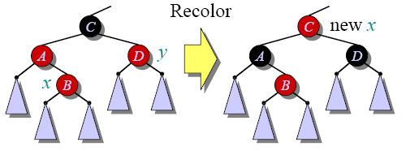
Case 1
(Or, children of
A are swapped.)
Push C’s black onto
A and D, and recurse,
since C’s parent may
be red.

Slide 57
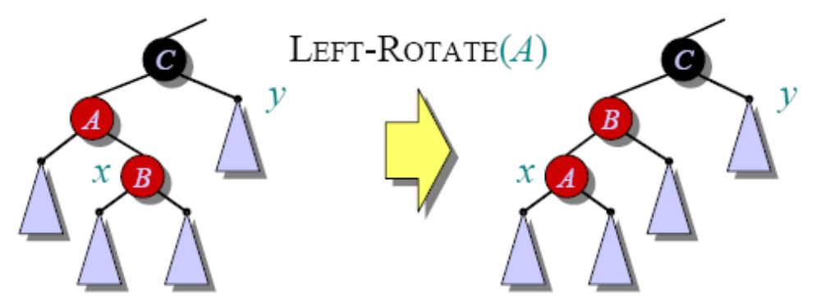
Case 2
Transform to Case 3.
© 2001 by Charles E. Leiserson Introduction to Algorithms
Day 18 L10.<number>

Slide 58
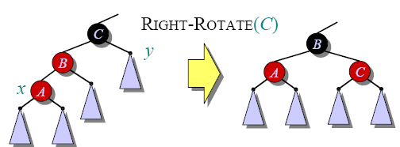
Case 3
Done! No more
violations of RB
property 3 are
possible.

Slide 59
Analysis
• Go up the tree performing Case 1, which only recolors nodes.
• If Case 2 or Case 3 occurs, perform 1 or 2
rotations, and terminate.
Running time: O(lg n) with O(1) rotations.
RB-DELETE— same asymptotic running time
and number of rotations as RB-INSERT (see
textbook).
Day 18 L10.<number>

Slide 60
Back to 2-3 Trees

Slide 61
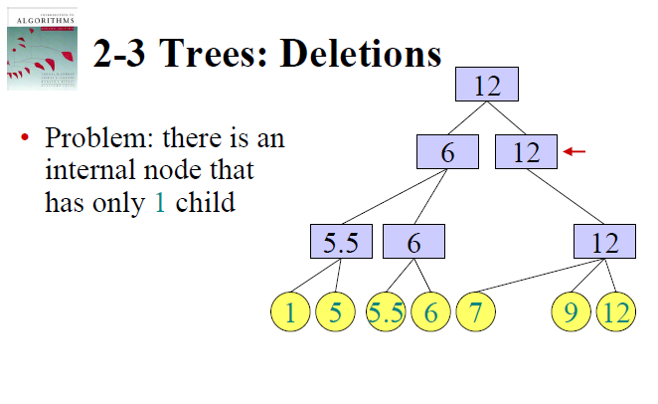

Slide 62
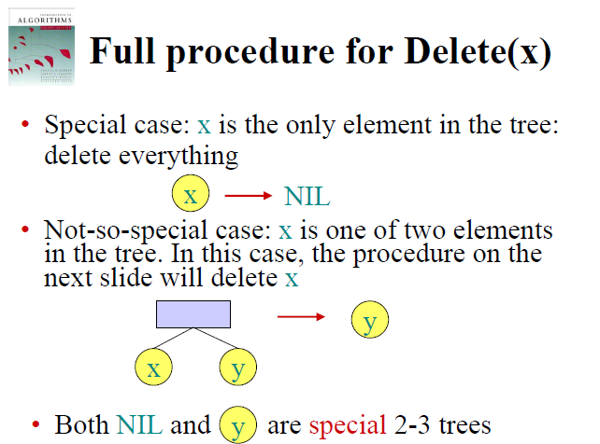

Slide 63
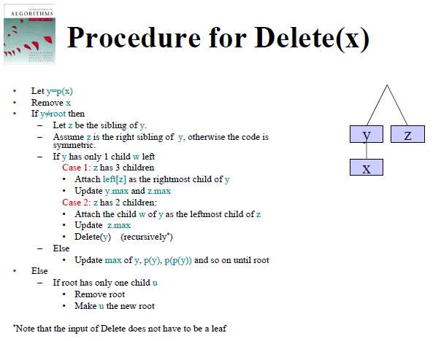

Slide 64
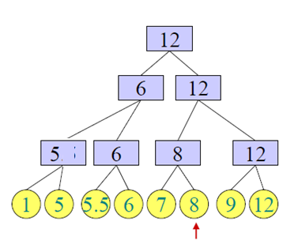
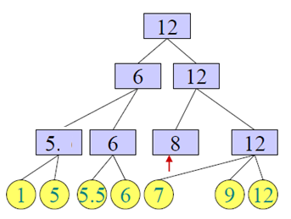
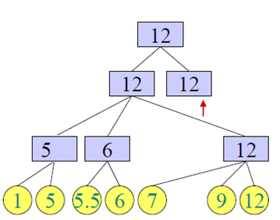


Slide 65
Summary
Binary Search Tree (BST) review
Red and Black Trees
2-3 and 2-3-4 trees
Operations on Red and Black Trees

